Slide 1
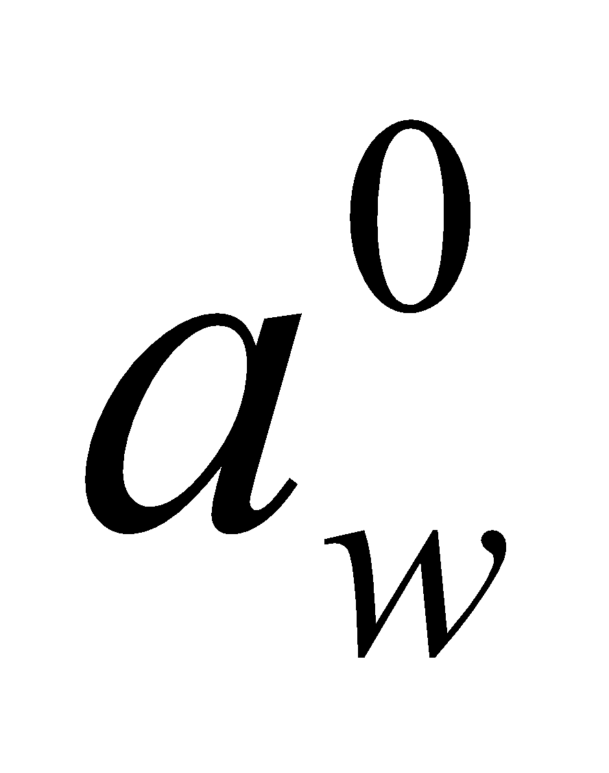
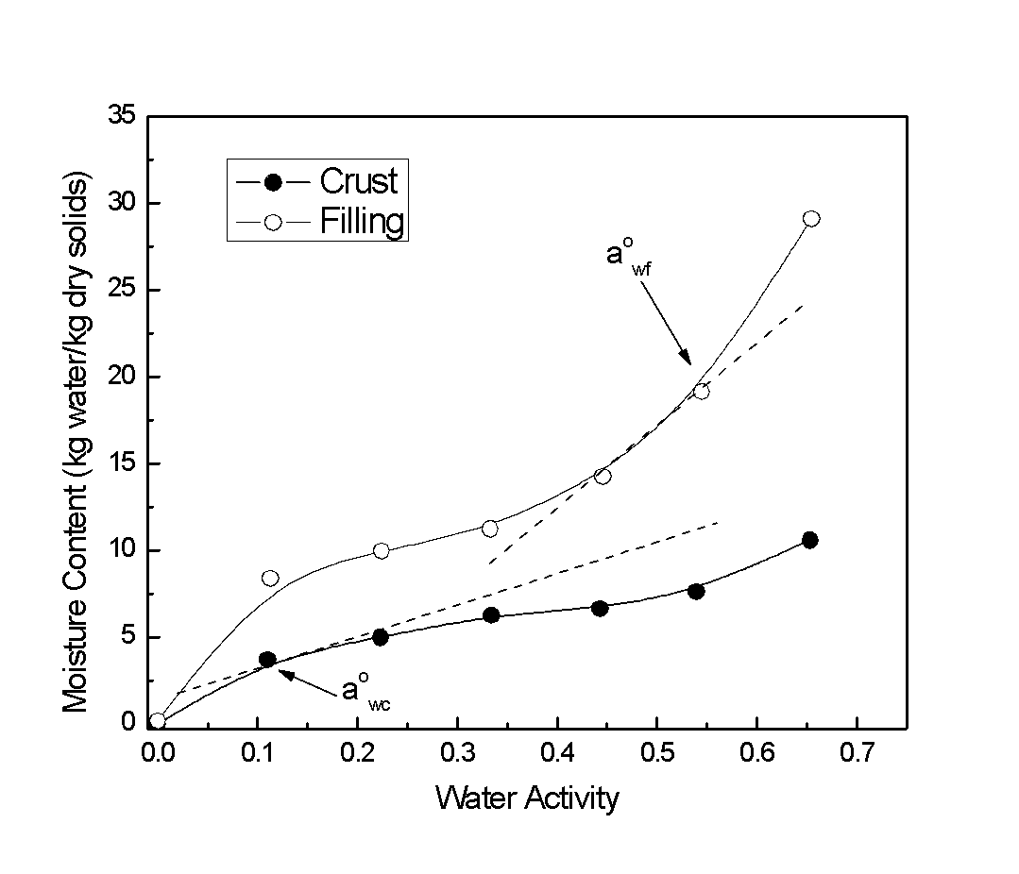
Calculate the equilibrium water activity and moisture contents of each ingredient of a product containing a high moisture soft center filling in a low moisture crust. Moisture isothermal and the initial water activities are given below. Assume a 50/50 mixture. Initial water activities of the products are 0.11 and 0.54 for the
crust and filling respectively

Slide 2
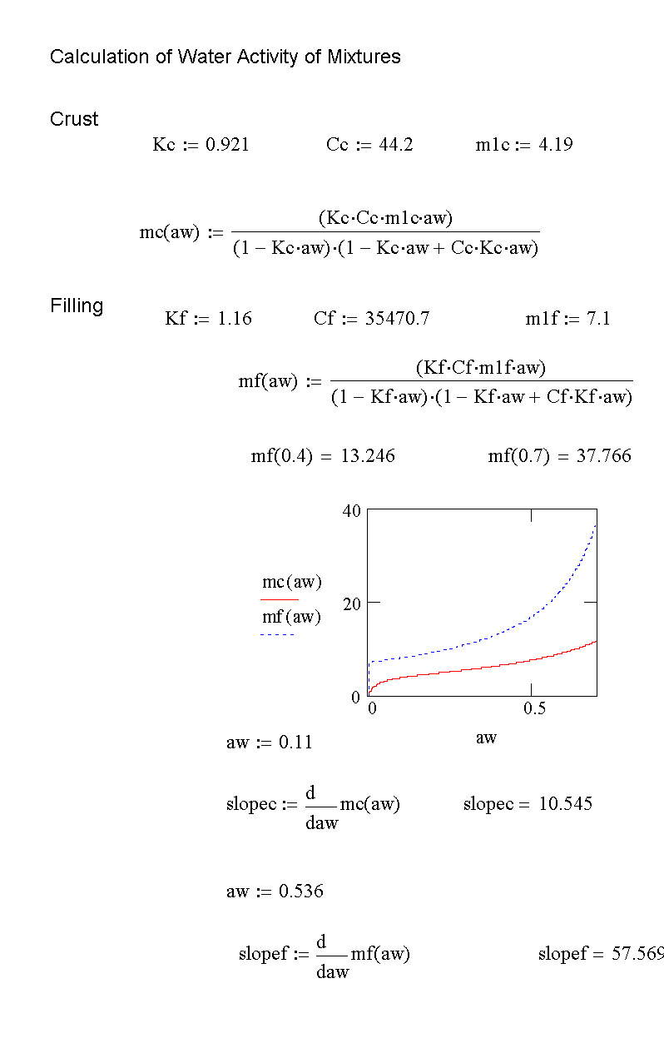

Slide 3
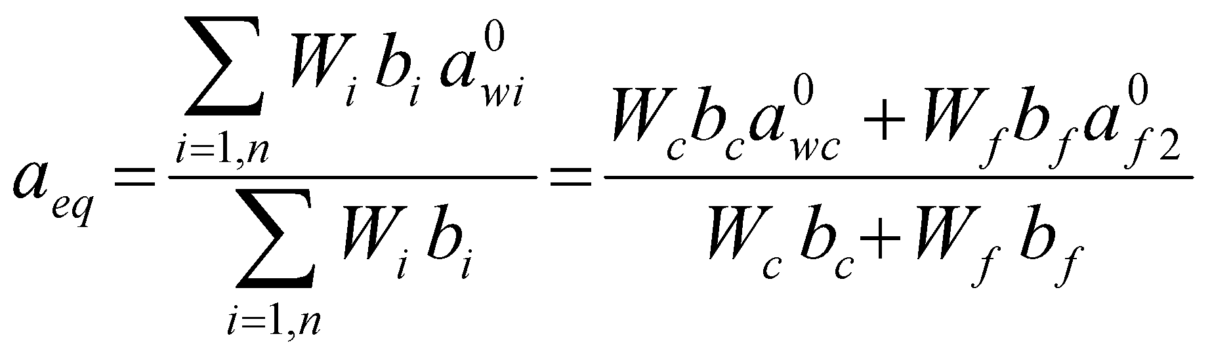
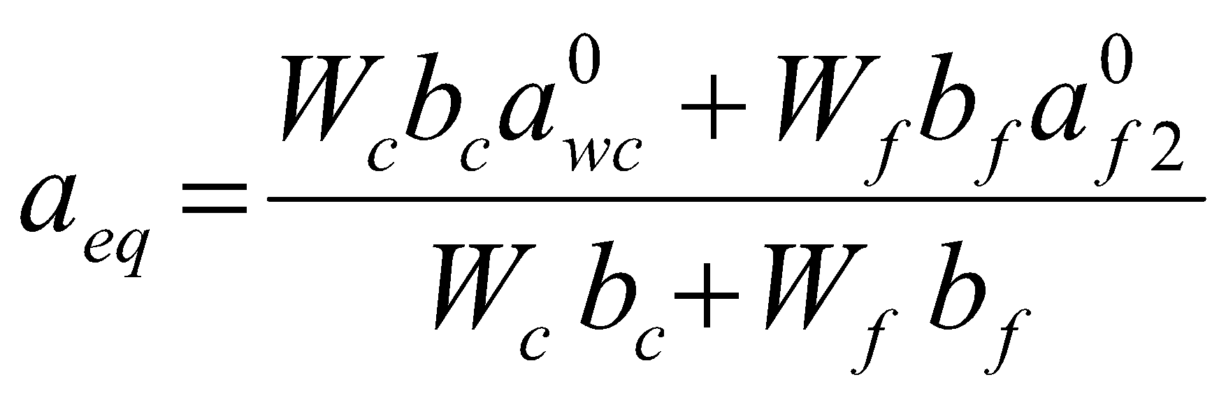
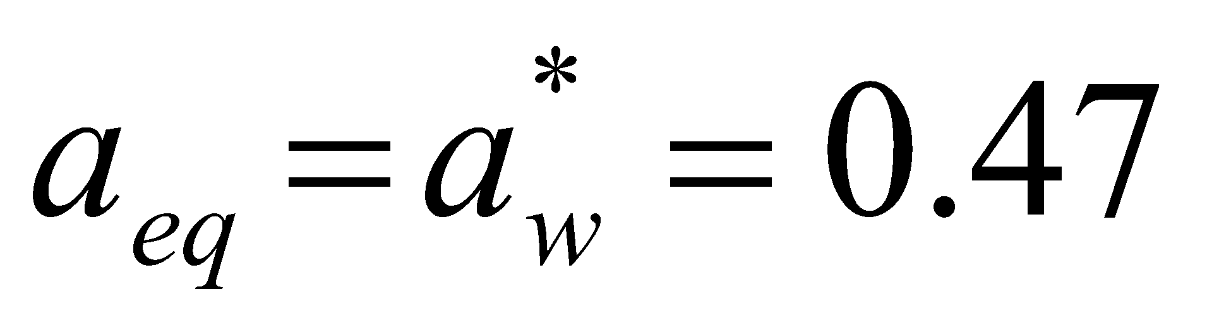

Slide 4
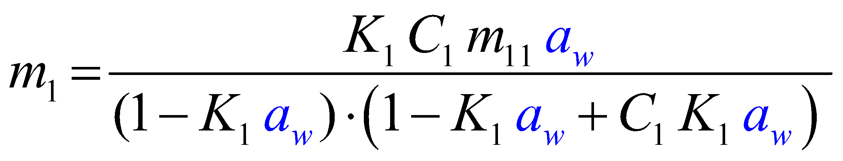
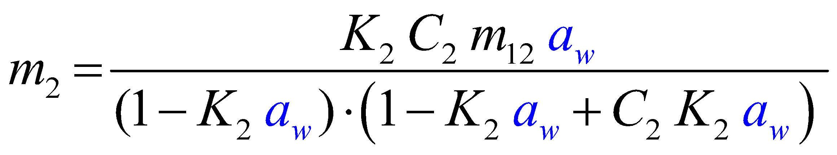
To assume that the sorption isotherm is a straight line may sometimes result
problematic. Could we use another function relating m and a_{w}?
Why we don’t use the GAB model (or the BET if it applies)?
Component 1
Component 2

Slide 5
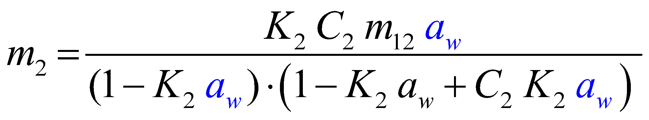
Water Activity of Mixtures
Component 1
Component 2
Mixture
m_{mix}?

Slide 6
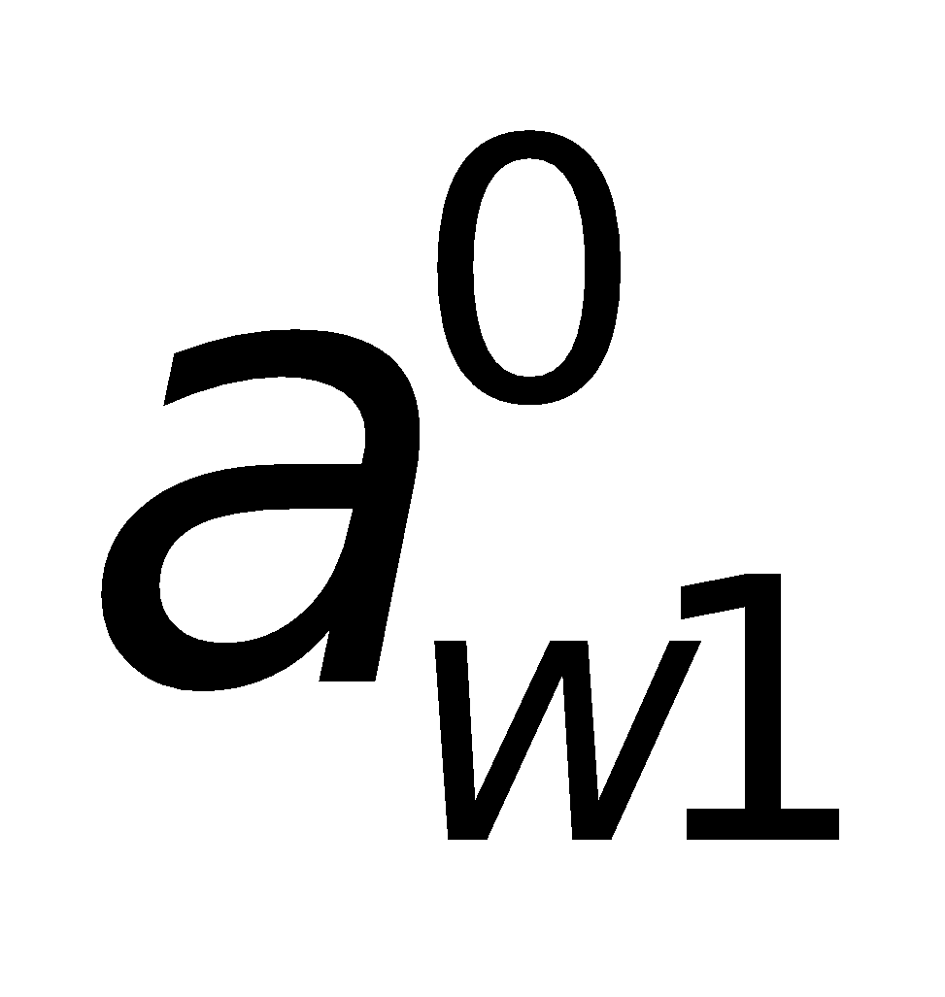
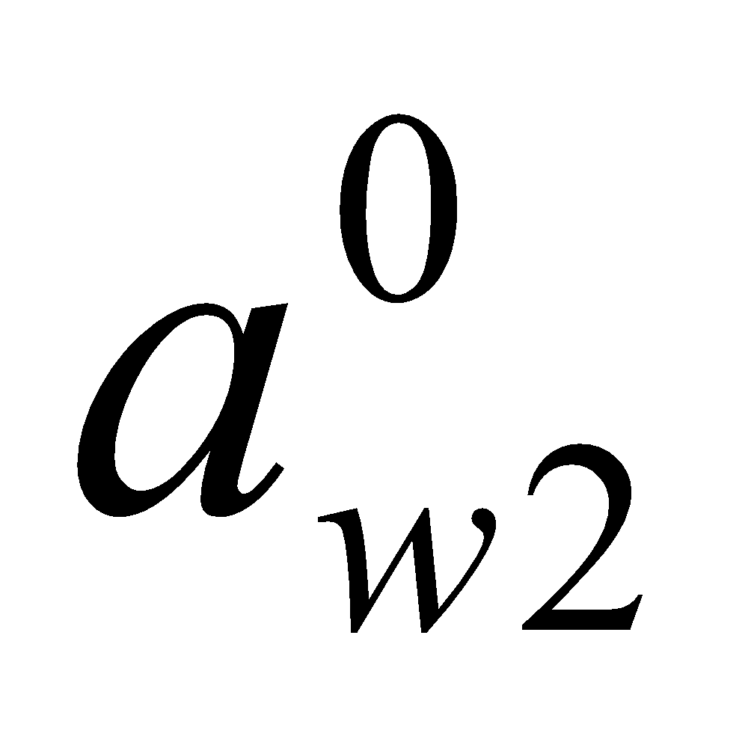
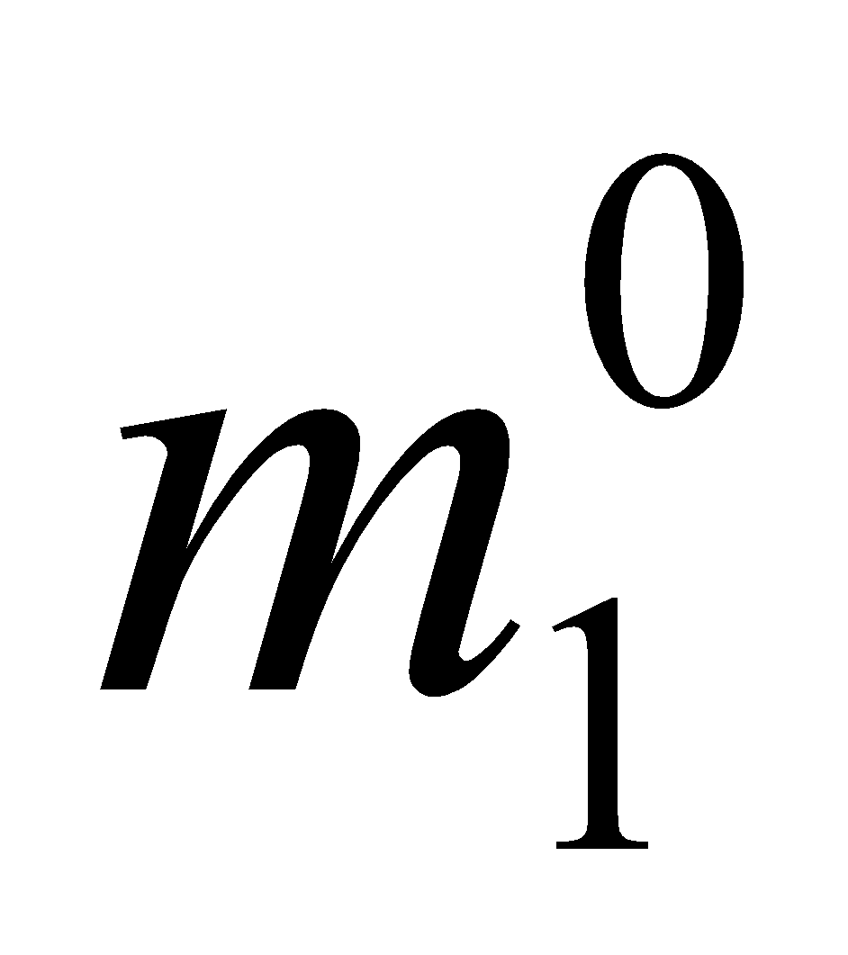
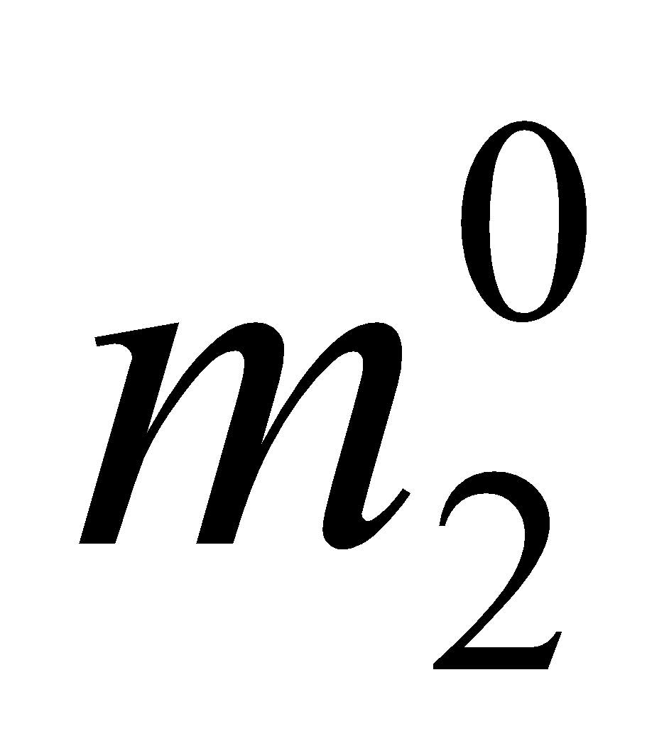
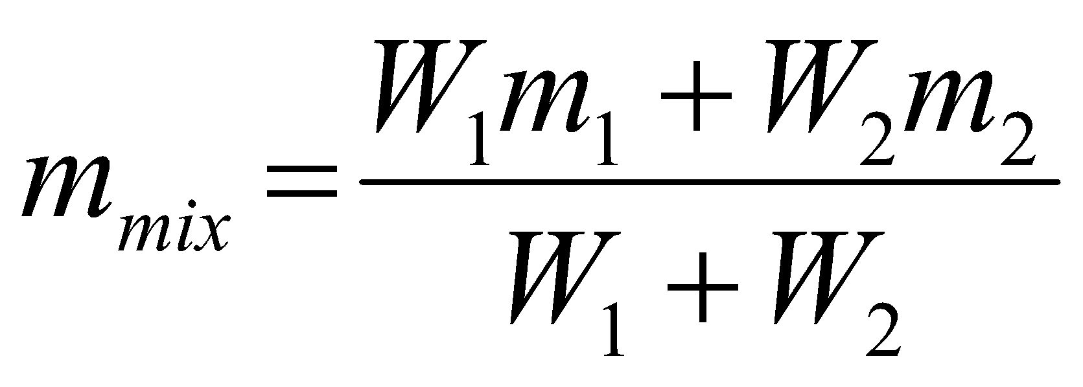
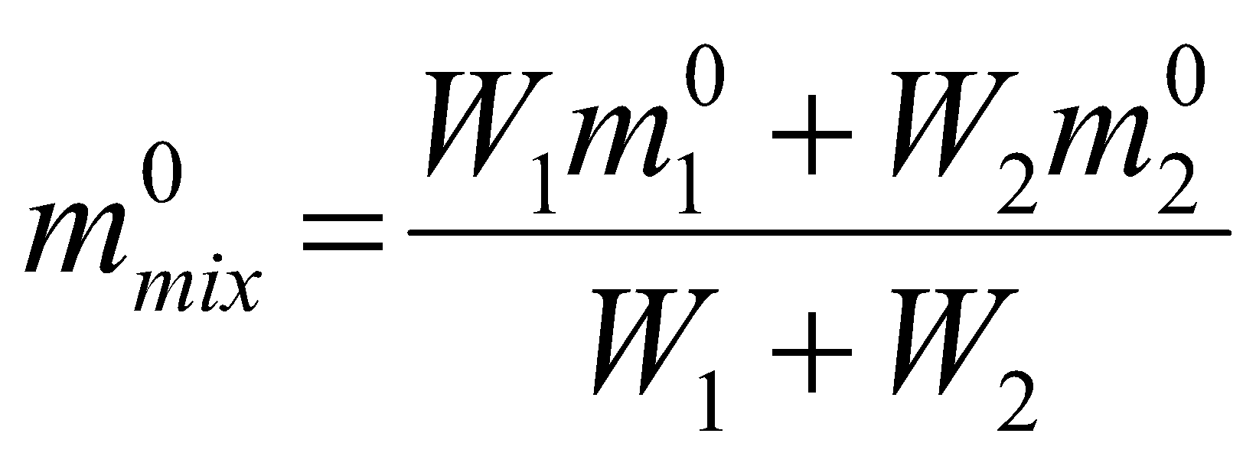
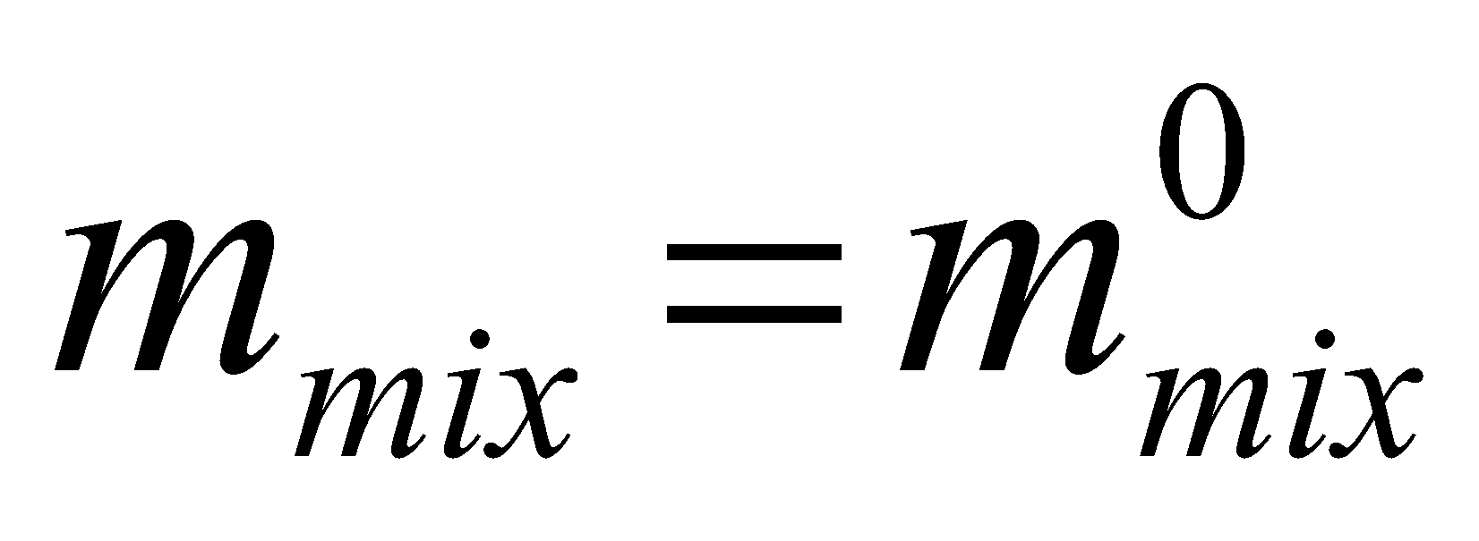
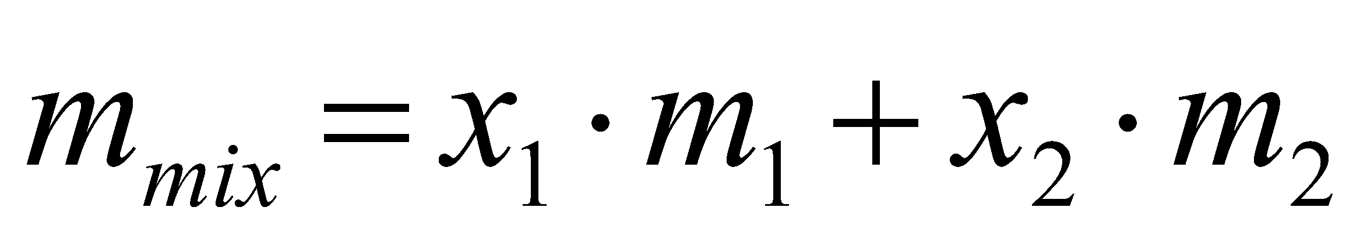
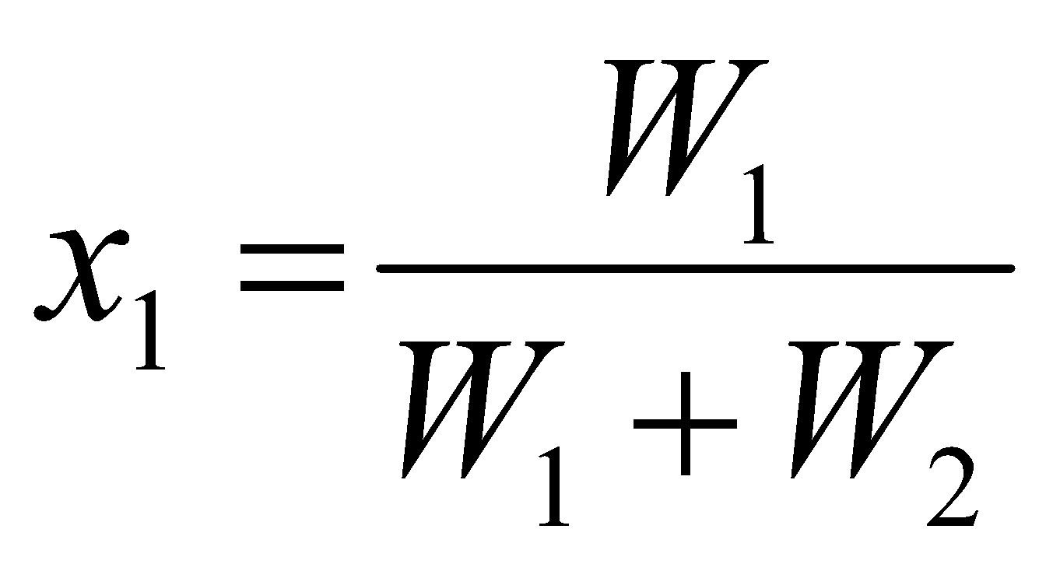
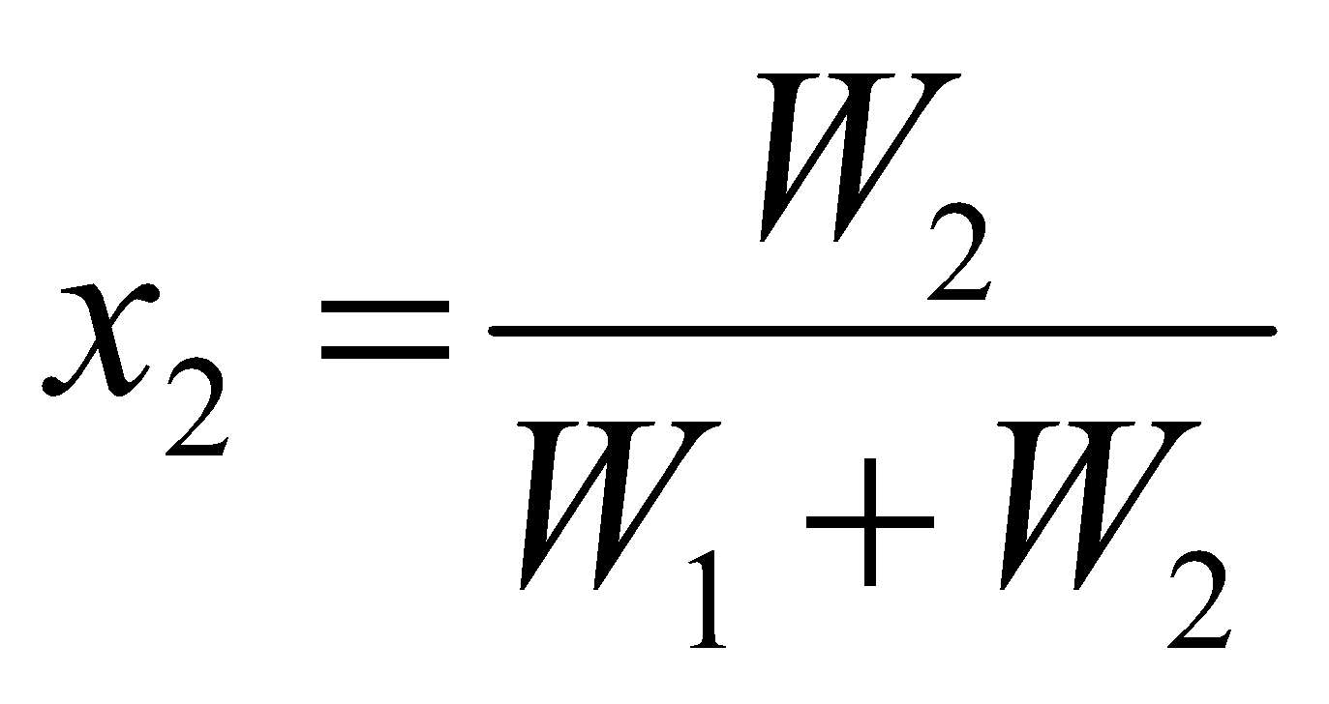
Water Activity of Mixtures
Component 1
Component 2
Mixture
If it is assumed that the components do not interact with each other
and no moisture is lost to the atmosphere (OK if they are in a package)

Slide 7
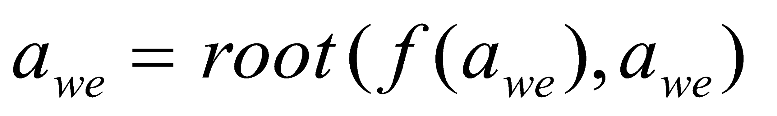
Water Activity of Mixtures
were a_{w,e} is the mixture equilibrium water activity
How we can calculate the equilibrium water activity of the mixture?
Using MathCad

Slide 8
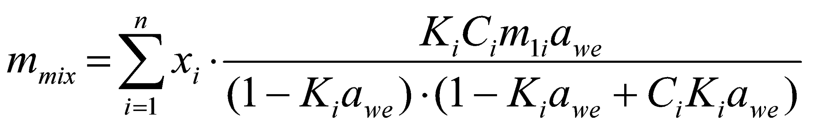
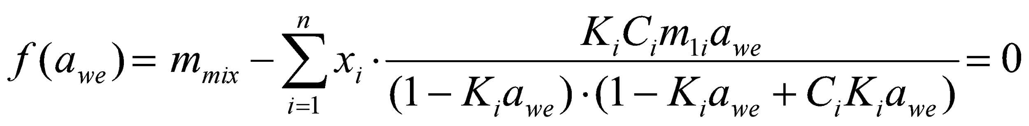
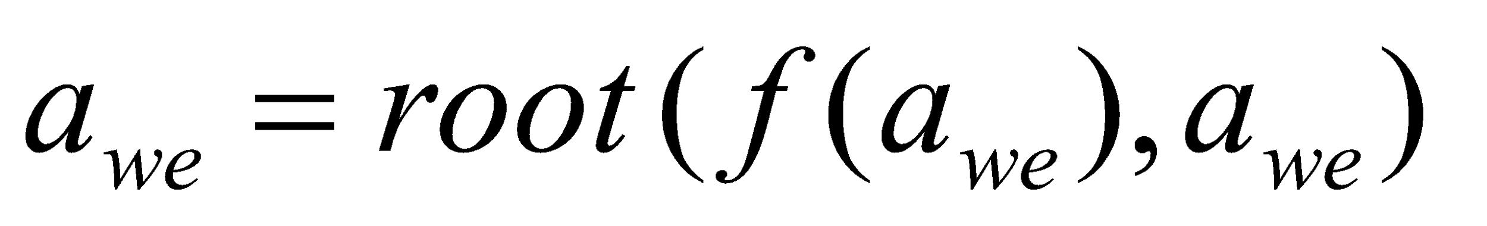
For n components
Using MathCad

Slide 9
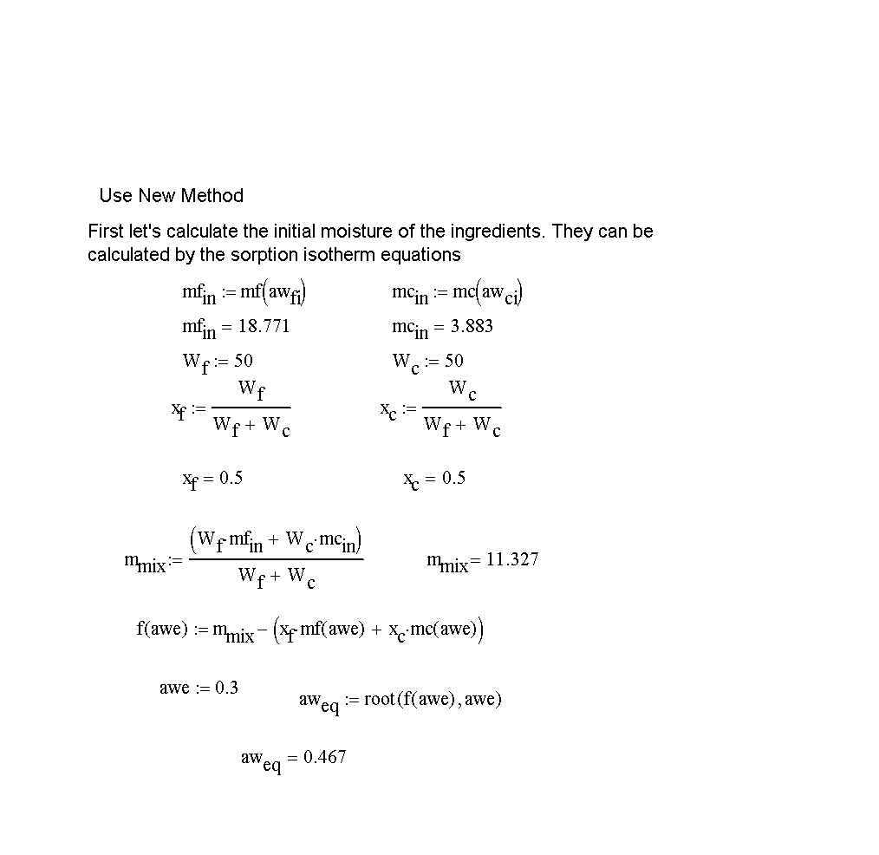

Slide 10
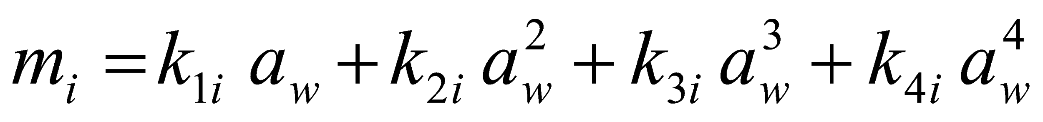
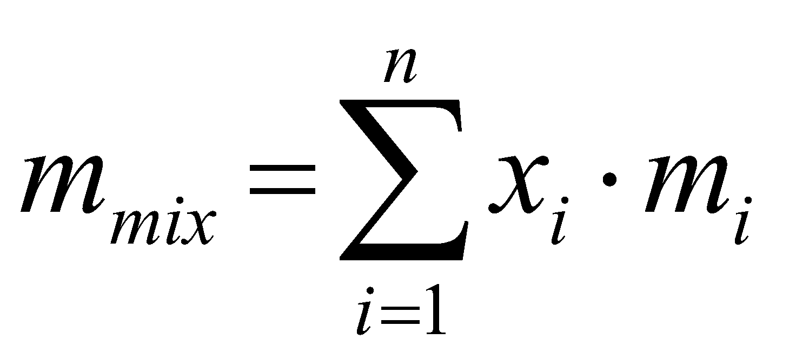
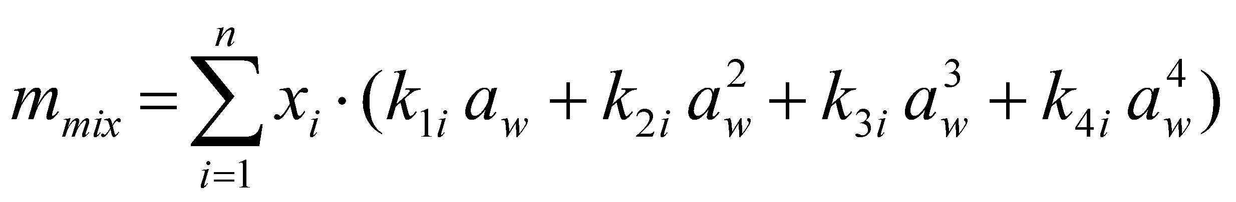
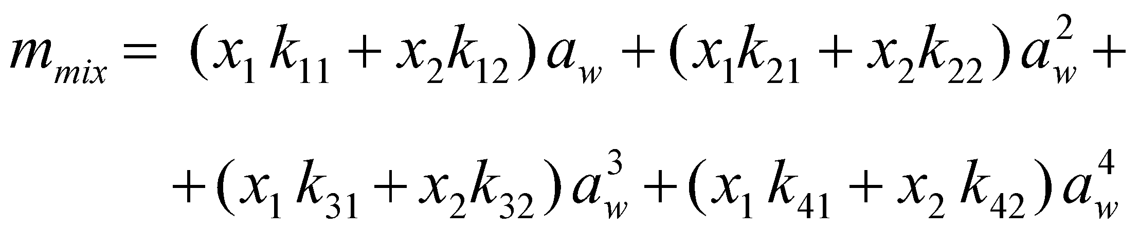
Third Approach (Peleg’s Method)
Approximate the sorption isotherm for a polynomial of n-order (e.g.4th order)
For 2-components

Slide 11
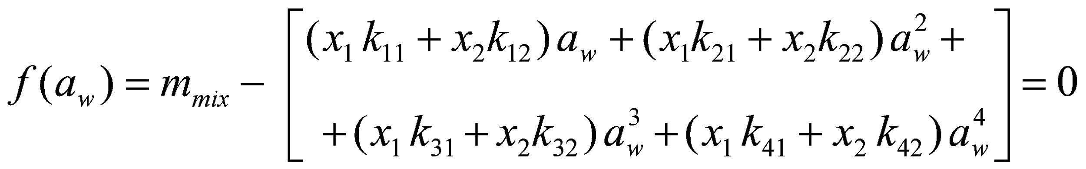
Using MathCad

Slide 12
